Slide 1
"THE BASIC PROBLEM OF SOFTWARE DEVELOPMENT IS RISK"
Notes:
It seems weird that Kent started his book with this statement, but what people really remember about XP is just Pair Programming, Unit Tests and eating pizza.
I think he was actually on to something really powerful right then and he didn't develop it further.
The reason is, he had these other fish to fry: he'd developed XP which, to him and many other people, was demonstrably better than the way we had been doing software development.
And so his book was just a catalog of all these "better" techniques, and how they could be used together.

Slide 2


Notes:
These approaches are more popular than XP nowadays.
Who uses Scrum at work? We’re going to talk a bunch about how Scrum has been accepted in Software Development.
Anyone use Lean or Kanban?
Does anyone still use Waterfall?

Slide 3
Notes:
I’m not here to rag on Waterfall.
Sometimes, Waterfall is the right way to go!
We'll dive into that in more detail in a minute, but it feels like collectively, as an industry, or a practice, software development has been on a path of discovery.

Slide 4
"WE ARE UNCOVERING BETTER WAYS OF DEVELOPING SOFTWARE BY DOING IT AND HELPING OTHERS DO IT.”
- Agile Manifesto
Notes:
Waterfall leads to XP and Scrum and Lean and Kanban, lately DevOps and so on.
Exactly as described in the Agile Manifesto.
But, Banking in particular seems to lag on these trends. Now, is there a reason why?
I think there is, and I’m going to explain that.

Slide 5
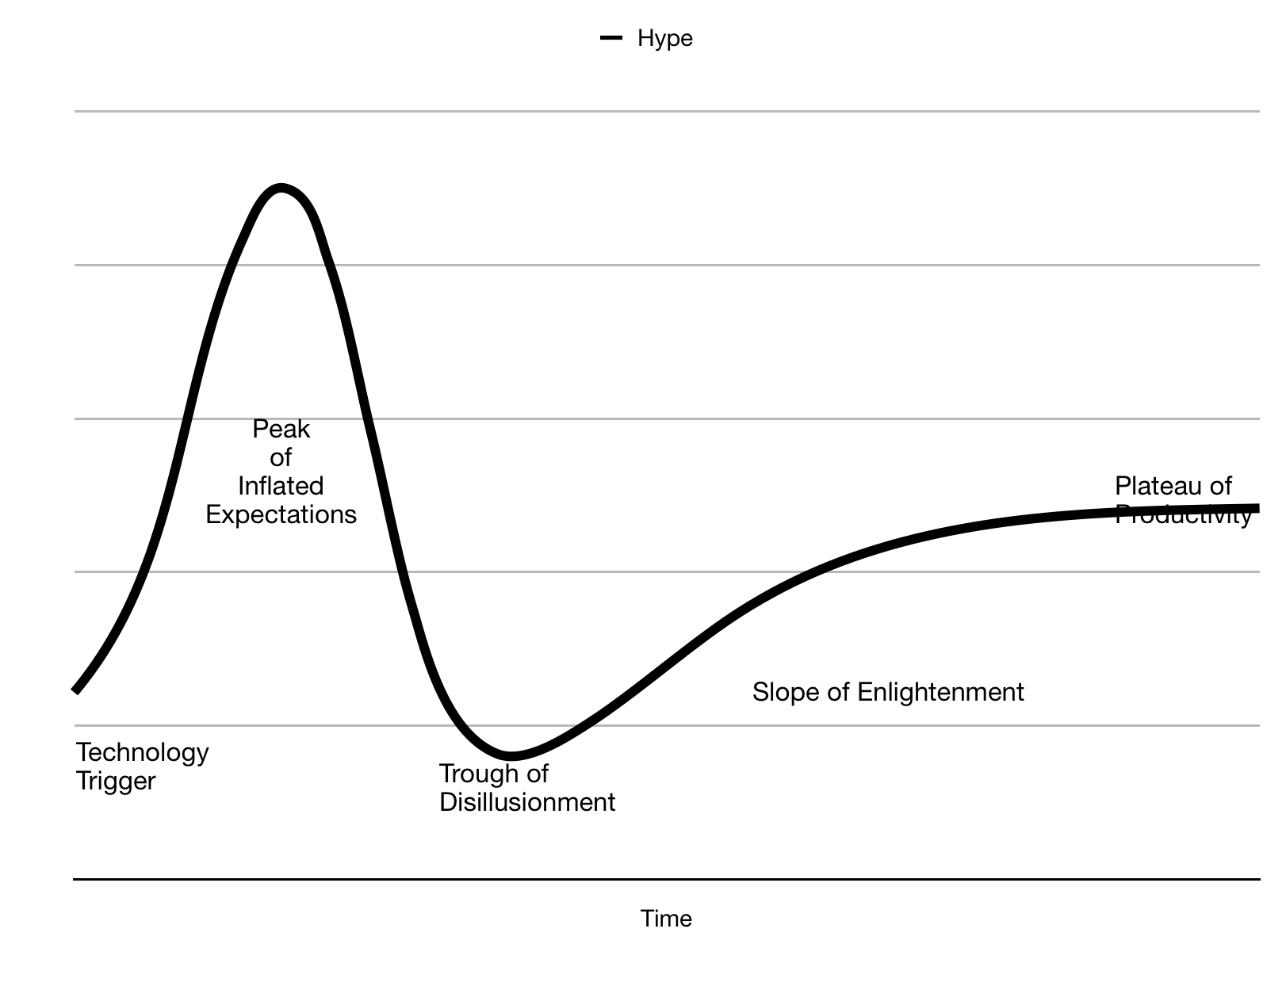
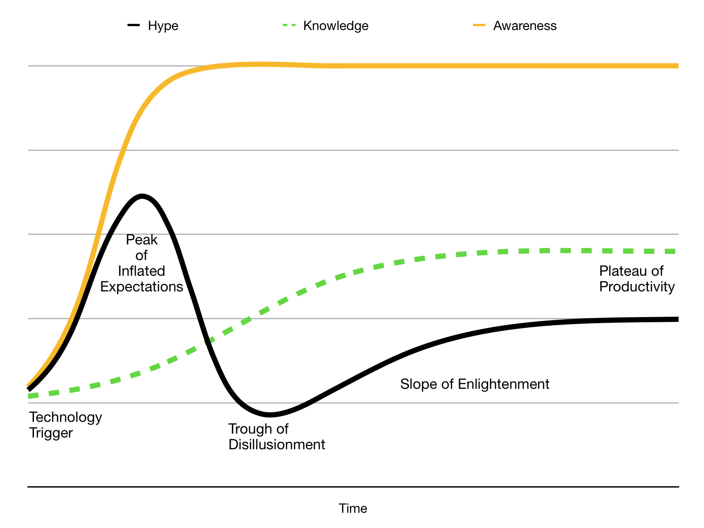
Notes:
Who know’s what this curve is?
It’s called a Hype Cycle.
Basically in a Hype-Cycle we have early adopters of a new idea picking up on it on the left hand side, and using it, and reporting success. And that leads to more awareness.
And more people pile in, using that technology for things that are maybe, not exactly what it was intended for. (The Peter Principle)
And after a while, we end up in this “Peak Of Inflated Expectations” where everyone is raving about a thing, without necessarily knowing all that much about it. So, like Bitcoin a year ago, or fidget spinners two years ago. Everyone was saying they’d cure ADHD for a while. Yeah.
Well anyway, it turns out that the more awareness increases beyond people’s actual knowledge of a thing, the bigger the hype is, and then the worse this crash into the “Trough of Disillusionment”.
Eventually, the knowledge of the thing increases in the population, and people pull out of the hype cycle into the slope of enlightenment and the plateau of productivity, because they know when something is useful, they’re not just jumping on a bandwagon.
They’ve figured out what that thing is useful for, and what it’s not for.
So people like Kent Beck were the far-left adopters on this curve. And, me and other people 20 years ago learning about and trying XP, we were on the left side.
But now, Deutsche Bank has an Agile month. And, it’s taken 20 years for this Hype Cycle to move from “Technology Trigger” to where it is now. And, I think there’s a lot of Agile hype now, so that probably means we are headed towards a trough of disillusionment, at least according to this model.
So, I guess the question is, why has that taken so long in Banking? Why weren’t they earlier on on this adoption curve.

Slide 6
Banking Regulations | XP
Known delivery date | Known priorities
Cooperation across departments | Small team, centrally located
Broadly, well defined expectations | Better for figuring things out as you go
Notes:
I think there are a few reasons.
First, big organisations are always slower to adapt. And, banks are large organisations. This is often because the people in charge already have their ways of doing things. It’s taken 20 years - a whole generation - for those ideas to change.
But I also suspect that it’s partly to do with the 2007 Financial Crisis. Certainly, in the risk departments I worked in, regulations started flying in from all directions.
And, the regulations always had a delivery date.
And, they generally required coordination across a large number of very disparate groups of people.
And, they were generally very clear in what they wanted to see.
I personally felt for a long while that those kinds of projects didn’t really lend themselves to an agile approach.
You were given a bunch of money, and told to make something happen across a large organisation, by a certain date.
You couldn’t put together a small team in a room, you couldn’t apply a process of iterating in two weeks.
So banking (and especially Risk, which I worked in) stuck with Waterfall for far longer than many other industries, I think.

Slide 7
"THE BASIC PROBLEM OF SOFTWARE DEVELOPMENT IS RISK"
Notes:
OK, so all this talk of Financial Crises and Waterfall is a bit tedious. Let’s mix things up a bit and do a quick Risk-First introduction.
When I was at school, I took Economics. We were 17 or 18 years old. And one of the guys just asks:
"What's the point of all this? Surely the markets are just people buying and selling stuff? They don't know about demand curves and price elasticity and all of these things!"
My economics teacher had to take quite a lot of shit actually. We were young and political and pretty annoying teenagers. But he gave a great answer:
"When footballers are playing a match of football, they have an understanding of how the ball works. But they don't need to be good physicists. Nevertheless, physical rules underpin the game they play.”

